Slide 1















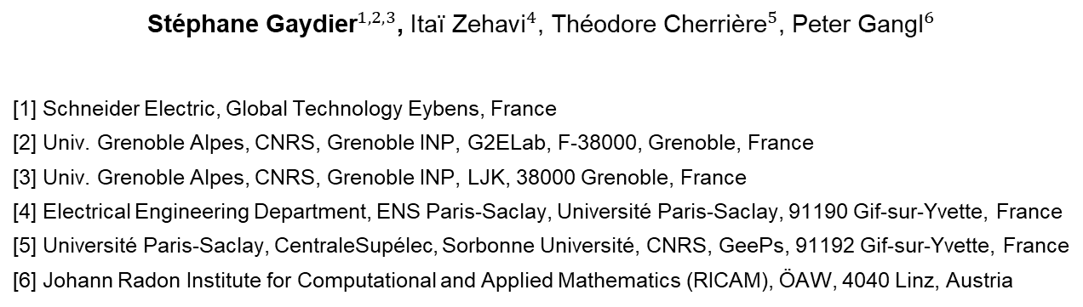
Air Gap Shape Optimization for Minimizing Proximity Effect Losses in an Inductor
${\text{St}\text{é}\text{phane} \text{Gaydier}}^{1, 2, 3}$, ${\text{Ita}\text{ï }\text{Zehavi}}^{4}$, ${\text{Th}\text{é}\text{odore} \text{Cherri}\text{è}\text{re}}^{5}$, ${\text{Peter} \text{G}\text{angl}}^{6}$
[1] Schneider Electric, Global Technology Eybens, France
[2] Univ. Grenoble Alpes, CNRS, Grenoble INP, G2ELab, F-38000, Grenoble, France
[3] Univ. Grenoble Alpes, CNRS, Grenoble INP, LJK, 38000 Grenoble, France
[4] Electrical Engineering Department, ENS Paris-Saclay, Université Paris-Saclay, 91190 Gif-sur-Yvette, France
[5] Université Paris-Saclay, CentraleSupélec, Sorbonne Université, CNRS, GeePs, 91192 Gif-sur-Yvette, France
[6] Johann Radon Institute for Computational and Applied Mathematics (RICAM), ÖAW, 4040 Linz, Austria
1

Slide 2
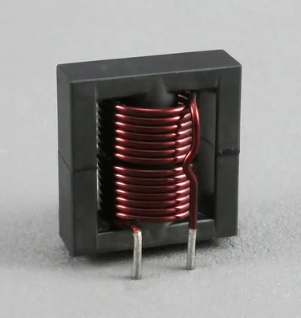
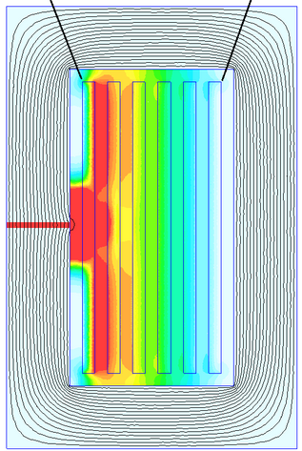
Introduction
We want to optimize an inductor to minimize the AC losses due to the fringing effect.
Possible solutions :
Distributed air gaps
Change winding distribution of the conductor [1]
Optimize air gap profile (e.g. with heuristic methods [2])
Our proposition : We optimize the air gap profile using gradient descent methods.
Converge faster
More flexible parametrization
[1] R.A. Jensen and C.R. Sullivan, “Optimal core dimensional ratios for minimizing winding loss in high-frequency gapped-inductor windings,”
[2] D.I. Zaikin, S. Jonasen, and S.L. Mikkelsen, “An Air-Gap Shape Optimization for Fringing Field Eddy Current Loss Reductions in Power Magnetics,”
[3] https://info.triadmagnetics.com/blog/basics-of-inductors
[4] https://www.e-magnetica.pl/doku.php/proximity_effect
An inductor [3]
Fringing Effect [4]

Slide 3
Outline
Introduction
Part I – Optimization Problem
Part II – Methodology
Part III – Optimization Results
Conclusion

Slide 4
Part I – Optimization Problem

Slide 5
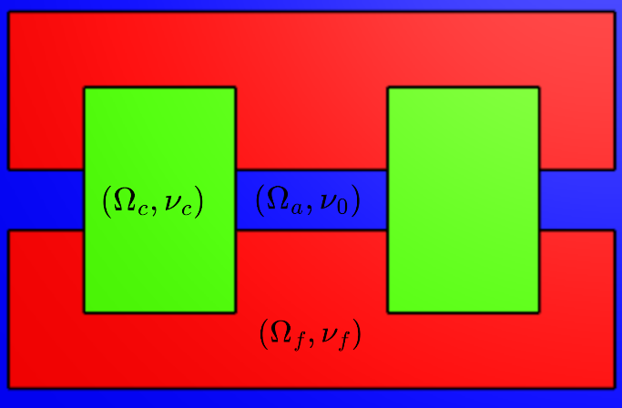
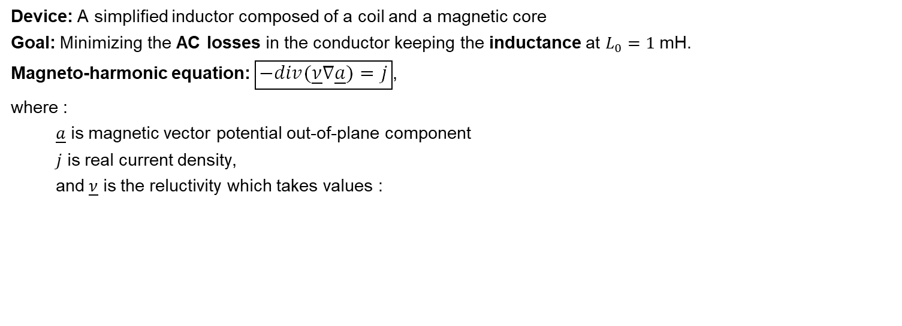
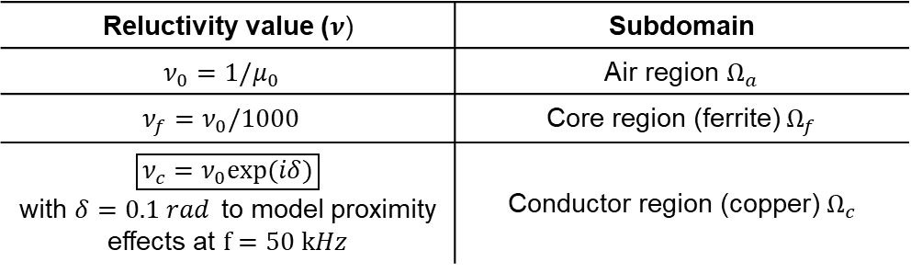
Device and modeling
Device: A simplified inductor composed of a coil and a magnetic core
Goal: Minimizing the AC losses in the conductor keeping the inductance at $L_{0}=1$mH.
Magneto-harmonic equation: $\boxed{−div(\underline{ν}​∇\underline{a}​)=j}$,
where :
$\underline{a}$​ is magnetic vector potential out-of-plane component
$j$ is real current density,
and$\underline{ν}$​ is the reluctivity which takes values :
Reluctivity value ($ν$) | Subdomain
$$ν_{0}=1/μ_{0}$$ | Air region $Ω_{a}$
$$ν_{f}=ν_{0}/1000$$ | Core region (ferrite) $Ω_{f}$
$\boxed{ν_{c}​​=ν_{0}​exp(iδ)}$ with $δ=0.1 rad$to model proximity effects at $f=50 kHz$ | Conductor region (copper) $Ω_{c}$
Reference design

Slide 6
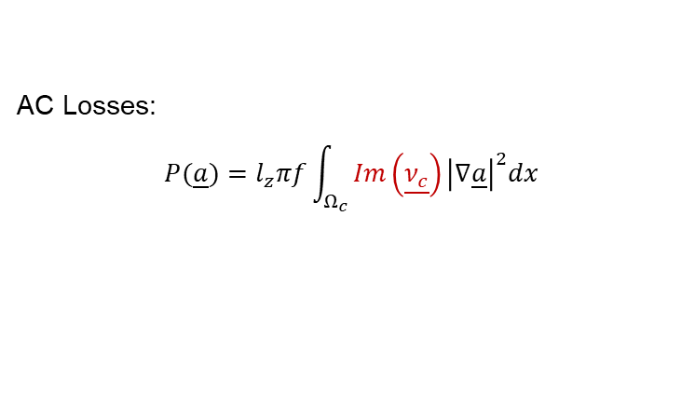
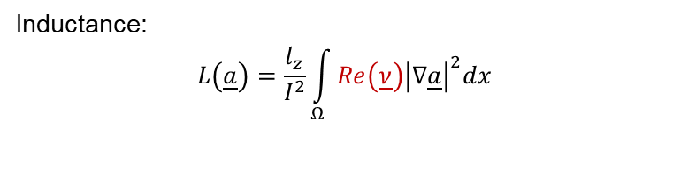
Objective and Constraint
The retained formulas are:
AC Losses:
$P(\underline{a})=l_{z}​πf\int_{Ω_{c}}{Im\left(\underline{ν_{c}}\right){\left|∇\underline{a}\right|}^{2}dx}$
Inductance:
$$L\left(\underline{a}\right)=\frac{l_{z}}{I^{2}}\int_{Ω}{Re\left(\underline{ν}\right){\left|∇\underline{a}\right|}^{2}dx}$$
with $l_{z}​=1 cm$ (thickness) and $I=2 A$(current, 200 turns).

Slide 7
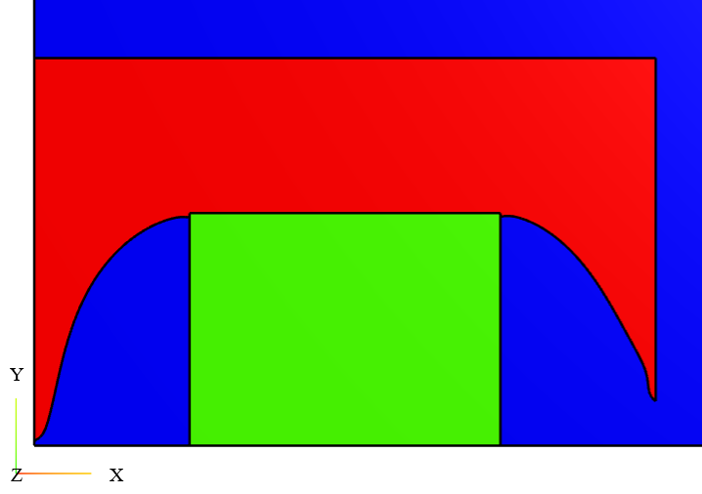
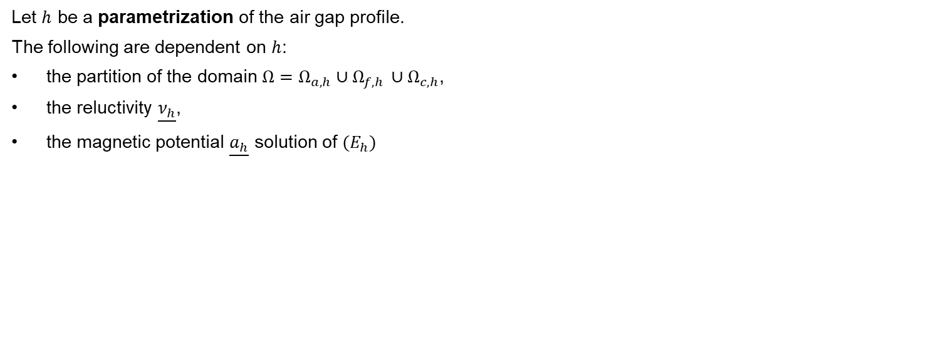
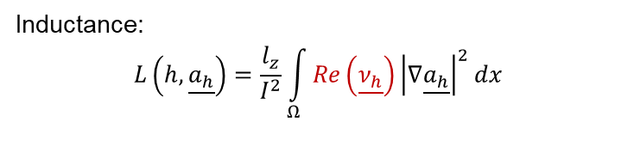
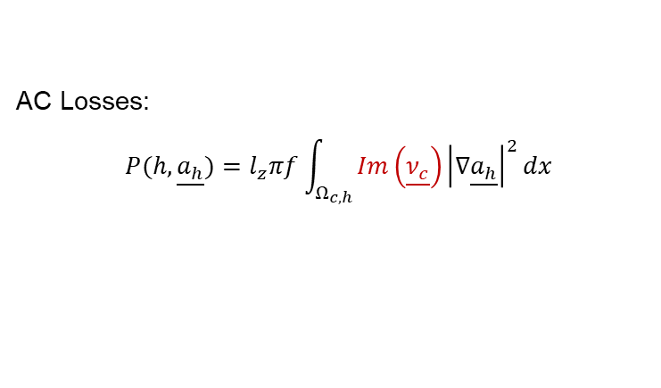
Parametrization
Let $h$ be a parametrization of the air gap profile.
The following are dependent on $h$:
the partition of the domain $Ω=Ω_{a, h}∪Ω_{f, h }∪Ω_{c, h}$,
the reluctivity $\underline{ν_{h}}$,
the magnetic potential $\underline{a_{h}}$ solution of ${(E}_{h})$
Parametrized air gap
$$Find \underline{a_{h}}∈H_{0}^{1}\left(Ω\right) such that ∀\underline{v}∈H_{0}^{1}\left(Ω\right),\int_{Ω }{\underline{ν_{h}}∇\underline{a_{h}}⋅∇\underline{v} dx}=\int_{Ω_{c, h}}{j\underline{v} dx}$$ | $$(E_{h})$$
Then, the objective and constraint rewrites into :
AC Losses:
$P(h,\underline{a_{h}})=l_{z}​πf\int_{Ω_{c,h}}{Im\left(\underline{ν_{c}}\right){\left|∇\underline{a_{h}}\right|}^{2}dx}$
Inductance:
$$L\left(h, \underline{a_{h}}\right)=\frac{l_{z}}{I^{2}}\int_{Ω}{Re\left(\underline{ν_{h}}\right){\left|∇\underline{a_{h}}\right|}^{2}dx}$$

Slide 8
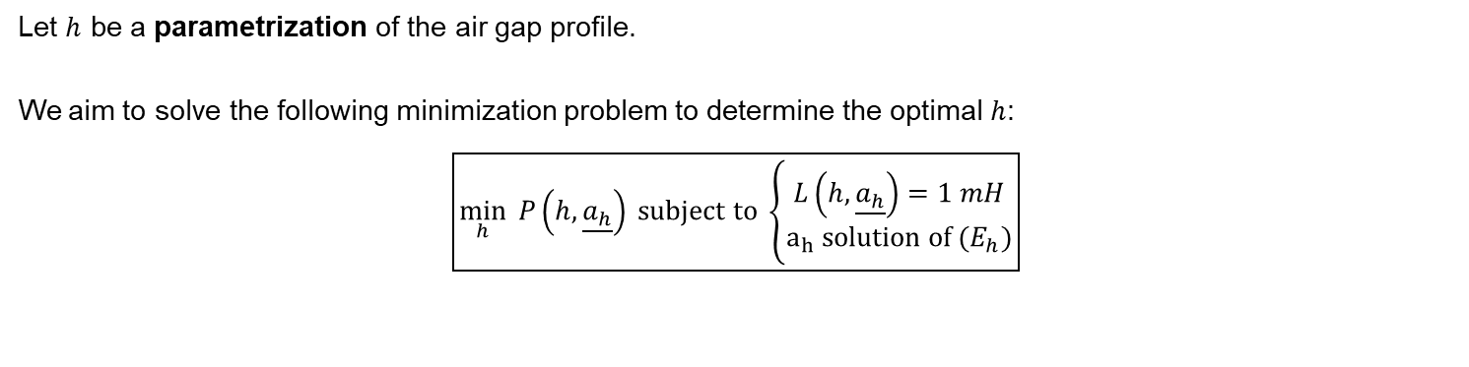
Constrained Minimization Problem
Let $h$ be a parametrization of the air gap profile.
We aim to solve the following minimization problem to determine the optimal $h$:
$$\boxed{\min_{h}{ P\left(h,\underline{a_{h}}\right)} subject to \left\{\begin{aligned}L\left(h,\underline{a_{h}}\right)=1 mH \\ a_{h} solution of (E_{h})\end{aligned}\right.}$$

Slide 9
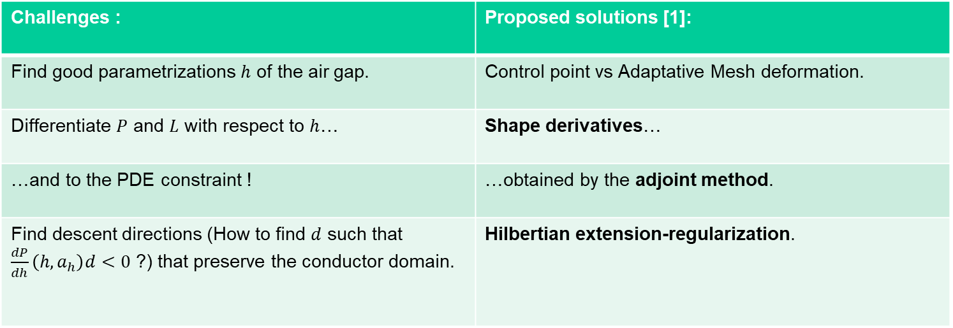
Challenges and Solutions
Challenges : | Proposed solutions [1]:
Find good parametrizations $h$ of the air gap. | Control point vs Adaptative Mesh deformation.
Differentiate $P$ and $L$ with respect to $h$… | Shape derivatives…
…and to the PDE constraint ! | …obtained by the adjoint method.
Find descent directions (How to find $d$ such that $\frac{dP}{dh}\left(h, a_{h}\right)d<0$ ?) that preserve the conductor domain. | Hilbertian extension-regularization.
We are using a handwritten augmented Lagrangian algorithm to solve this constrained optimization problem.
[1] G. Allaire, C. Dapogny, and F. Jouve, “Shape and topology optimization,” in Handbook of Numerical Analysis

Slide 10
Part II - Methodology

Slide 11
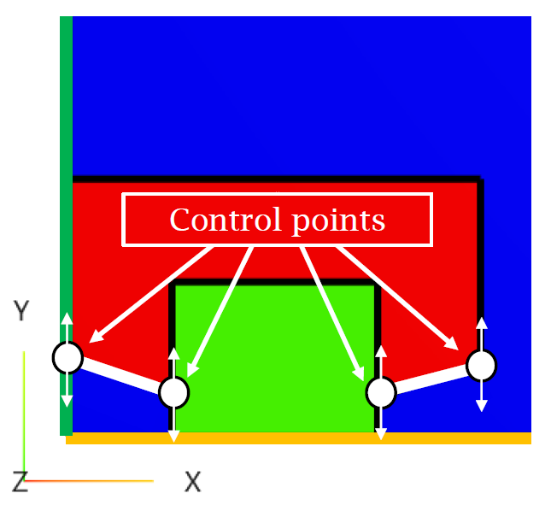
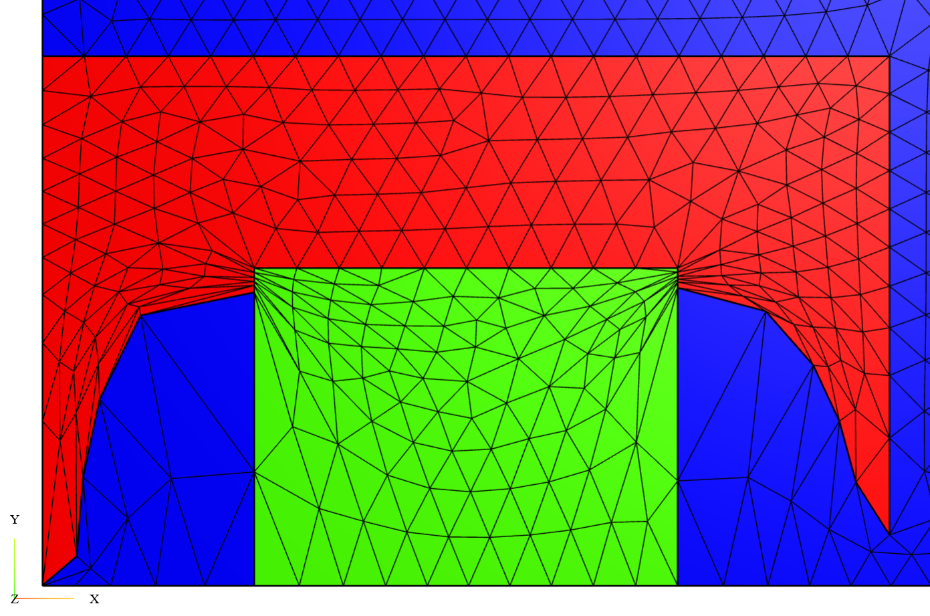
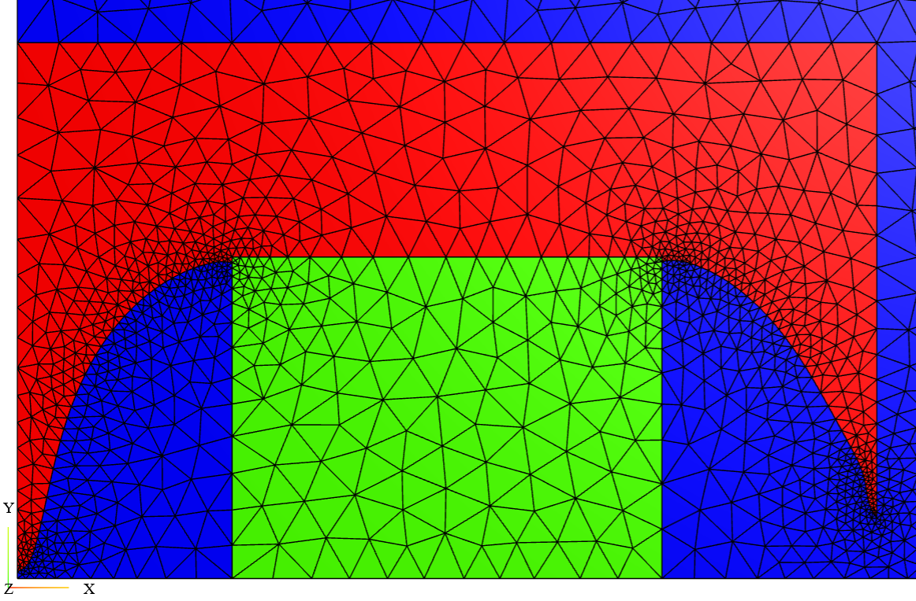

Two Choices for the Parametrization h
$h=(p_{1}, p_{2}, p_{3}, p_{4})$
$$h=(Ω_{a}, Ω_{f}, Ω_{c})$$
Parametric Shape Optimization using Control points
Geometric Shape Optimization by mesh deformation
Geometric Shape Optimization
by adaptative mesh deformation
using MMG [1]
[1] https://www.mmgtools.org/

Slide 12
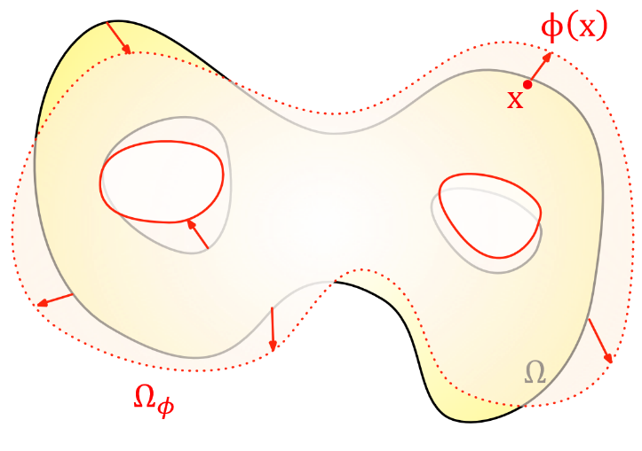
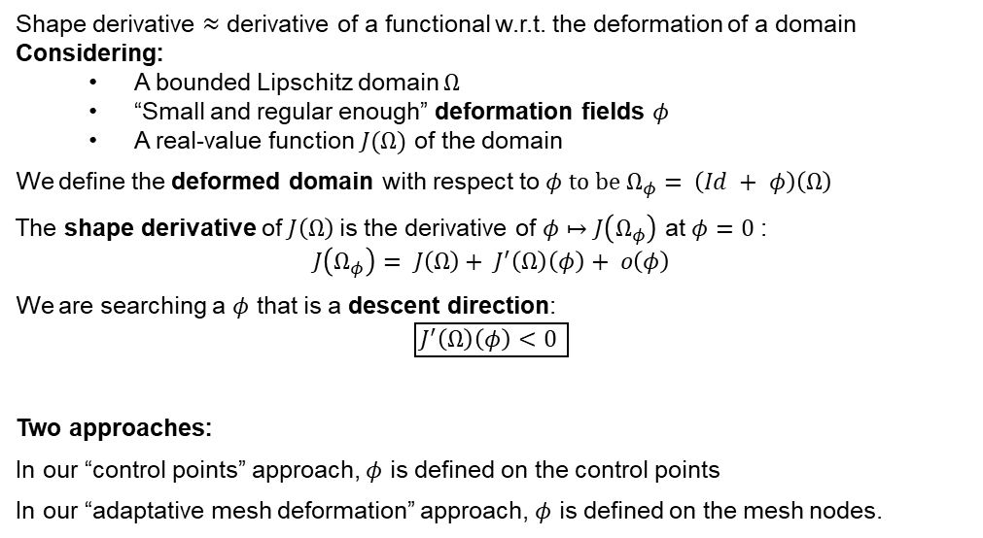
Shape derivatives
Shape derivative $≈$ derivative of a functional w.r.t. the deformation of a domain
Considering:
A bounded Lipschitz domain $Ω$
“Small and regular enough” deformation fields $φ$
A real-value function $J(Ω)$ of the domain
We define the deformed domain with respect to $φ to be$ $Ω_{φ}= \left(Id + φ\right)\left(Ω\right)$
The shape derivative of $J\left(Ω\right)$is the derivative of $φ↦J\left(Ω_{φ}\right)$ at $φ=0$ :
$$J\left(Ω_{φ}\right)= J\left(Ω\right)+ J^{′}\left(Ω\right)\left(φ\right)+ o\left(φ\right)$$
We are searching a $φ$ that is a descent direction:
$$\boxed{J^{′}\left(Ω\right)\left(φ\right)<0 }$$
Two approaches:
In our “control points” approach, $φ$ is defined on the control points
In our “adaptative mesh deformation” approach, $φ$ is defined on the mesh nodes.
Deformed domain

Slide 13
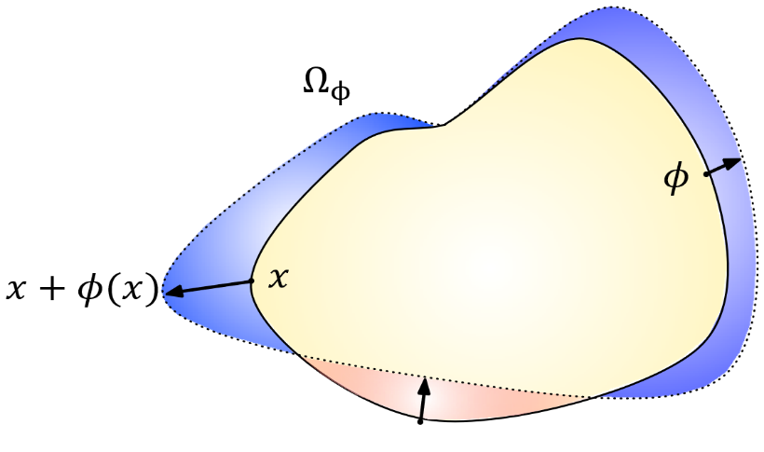
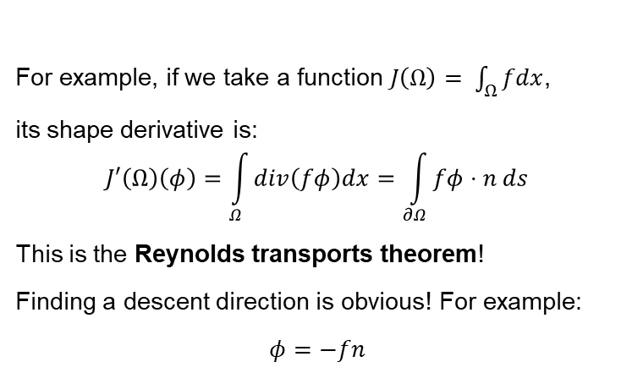
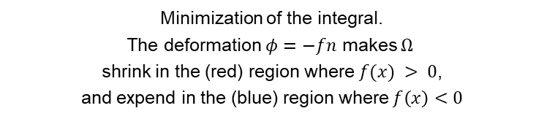
Example of a Shape Derivative
For example, if we take a function $J\left(Ω\right)= \int_{Ω}{fdx}$,
its shape derivative is:
$$J′\left(Ω\right)\left(φ\right)=\int_{Ω}{div\left(fφ\right)dx}=\int_{∂Ω}{fφ⋅n ds}$$
This is the Reynolds transports theorem!
Finding a descent direction is obvious! For example:
$$φ=−fn$$
Minimization of the integral.
The deformation $φ=−fn$ makes $Ω$
shrink in the (red) region where $f(x) > 0$,
and expend in the (blue) region where $f\left(x\right)<0$

Slide 14
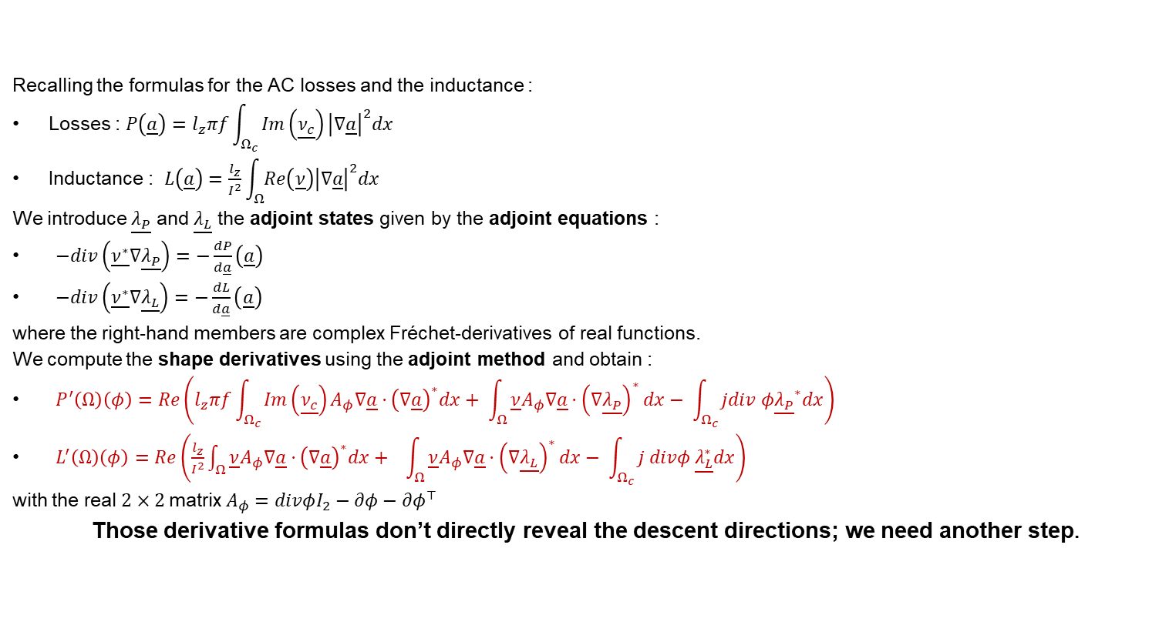
Shape Derivatives of Losses & Inductance
Recalling the formulas for the AC losses and the inductance :
Losses : $P\left(\underline{a}\right)=l_{z}​πf\int_{Ω_{c}}{Im\left(\underline{ν_{c}}\right){\left|∇\underline{a}\right|}^{2}dx}$
Inductance : $L\left(\underline{a}\right)=\frac{l_{z}}{I^{2}}\int_{Ω}{Re\left(\underline{ν}\right){\left|∇\underline{a}\right|}^{2}dx}$
We introduce $\underline{λ_{P}}$ and $\underline{λ_{L}}$ the adjoint states given by the adjoint equations :
$−div\left(\underline{ν^{∗}}∇\underline{λ_{P}}\right)=−\frac{dP}{d\underline{a}}\left(\underline{a}\right)$
$−div\left(\underline{ν^{∗}}∇\underline{λ_{L}}\right)=−\frac{dL}{d\underline{a}}\left(\underline{a}\right)$
where the right-hand members are complex Fréchet-derivatives of real functions.
We compute the shape derivatives using the adjoint method and obtain :
$P^{′}\left(Ω\right)\left(φ\right)=Re\left(l_{z}πf\int_{Ω_{c}}{Im\left(\underline{ν_{c}}\right)A_{φ}∇\underline{a}⋅{\left(∇\underline{a}\right)}^{∗}dx}+ \int_{Ω}{\underline{ν}A_{φ}∇\underline{a}⋅{\left(∇\underline{λ_{P}}\right)}^{∗}dx}− \int_{Ω_{c}}{jdiv φ{\underline{λ_{P}}}^{∗}dx}\right)$
$L^{′}\left(Ω\right)\left(φ\right)=Re\left(\frac{l_{z}}{I^{2}}\int_{Ω}{\underline{ν}A_{φ}∇\underline{a}⋅{\left(∇\underline{a}\right)}^{∗}dx}+ \int_{Ω}{\underline{ν}A_{φ}∇\underline{a}⋅{\left(∇\underline{λ_{L}}\right)}^{∗}dx}− \int_{Ω_{c}}{j divφ \underline{λ_{L}^{∗}}dx}\right)$
with the real $2×2$matrix$A_{φ}=divφI_{2}−∂φ−∂φ^{⊤}$
Those derivative formulas don’t directly reveal the descent directions; we need another step.

Slide 15
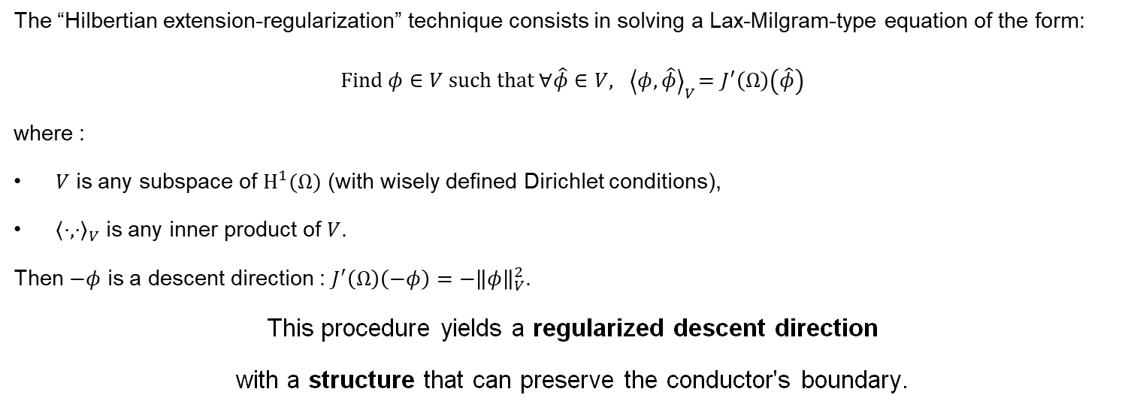
Hilbertian Extension-Regularization
The “Hilbertian extension-regularization” technique consists in solving a Lax-Milgram-type equation of the form:
$$Find φ∈V such that ∀\hat{φ}∈V, { \left\langle φ, \hat{φ}\right\rangle }_{V}=J^{′}\left(Ω\right)\left(\hat{φ}\right)$$
where :
$V$ is any subspace of $H^{1}(Ω)$ (with wisely defined Dirichlet conditions),
${\left\langle ⋅,⋅\right\rangle }_{V}$ is any inner product of $V$.
Then $−φ$ is a descent direction : $J^{′}\left(Ω\right)\left(−φ\right)=−{\left\|φ\right\|}_{V}^{2}$.
This procedure yields a regularized descent direction
with a structure that can preserve the conductor's boundary.

Slide 16
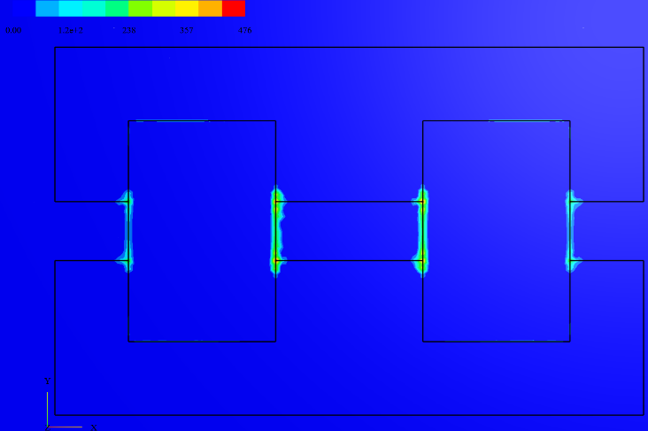
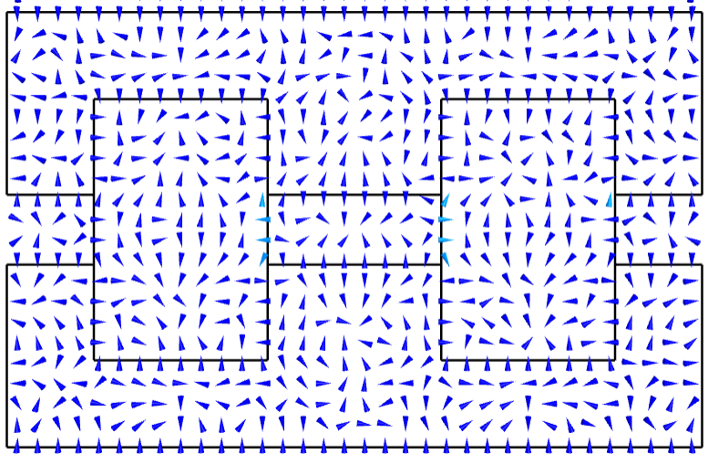
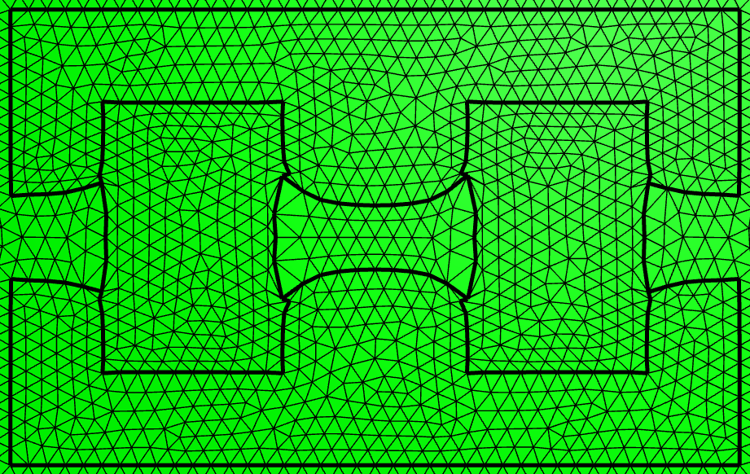
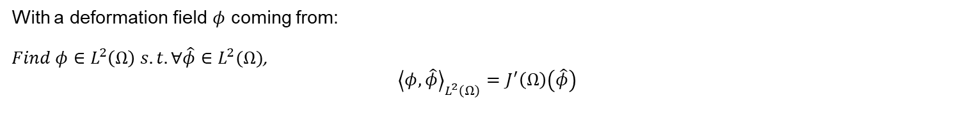


Unregularized the Deformation Field
With a deformation field $φ$ coming from:
$Find φ∈L^{2}\left(Ω\right) s.t.∀\hat{φ}∈L^{2}(Ω)$, $${\left\langle φ, \hat{φ}\right\rangle }_{L^{2}\left(Ω\right)}=J^{′}\left(Ω\right)\left(\hat{φ}\right)$$
Norm of $−φ$
Vector field $−φ$
Deformed mesh

Slide 17
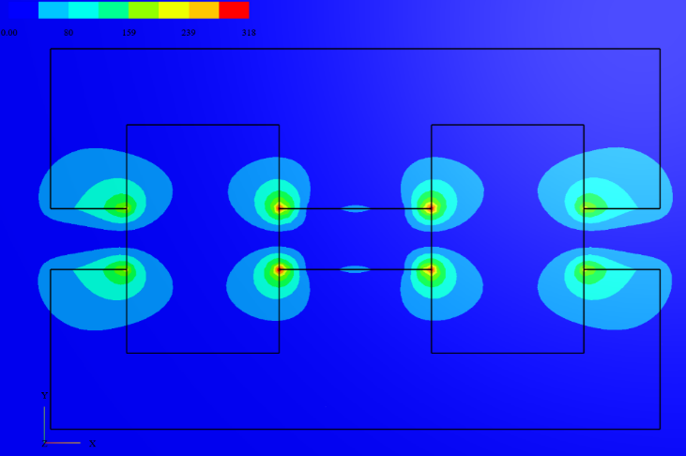
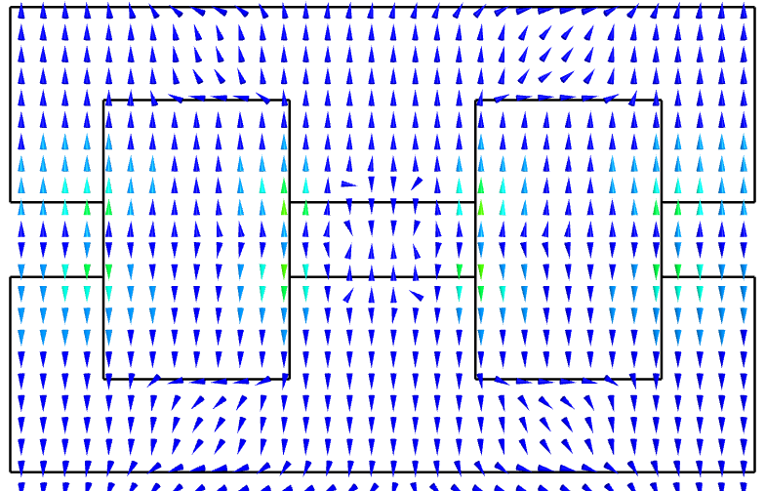
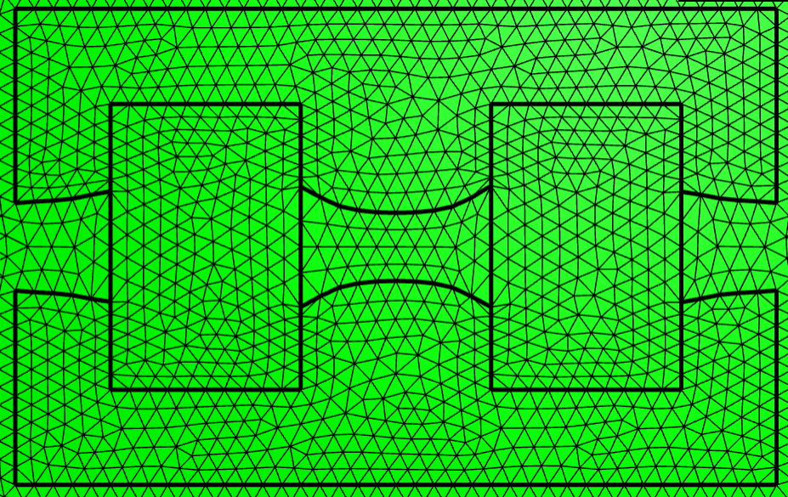
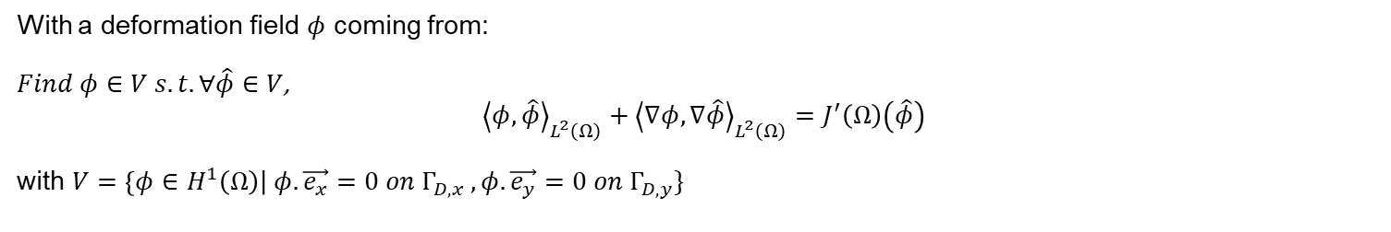
Regularized Deformation Field
With a deformation field $φ$ coming from:
$Find φ∈V s.t.∀\hat{φ}∈V$, $${\left\langle φ, \hat{φ}\right\rangle }_{L^{2}\left(Ω\right)}+{\left\langle ∇φ, ∇\hat{φ}\right\rangle }_{L^{2}\left(Ω\right)}=J^{′}\left(Ω\right)\left(\hat{φ}\right)$$
with $V=\left\{φ∈H^{1}\left(Ω\right)\right| φ. \vec{e_{x}}=0 on Γ_{D, x} , φ. \vec{e_{y}}=0 on Γ_{D, y}\}$
Norm of $−φ$
Vector field $−φ$
Deformed mesh

Slide 18
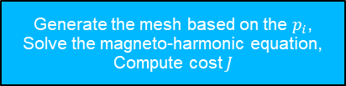
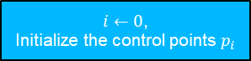


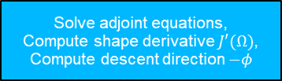
Control Points Flowchart
End
Yes
Convergence ?
$i←0$,
Initialize the control points $p_{i}$
Generate the mesh based on the $p_{i}$,
Solve the magneto-harmonic equation,
Compute cost $J$
Start
No
Solve adjoint equations,
Compute shape derivative $J′(Ω)$,
Compute descent direction $−φ$
$$i←i+1$$
Update the control points:
$p_{i}←p_{i}−τφ_{i}$

Slide 19

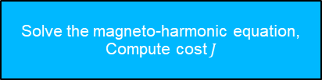

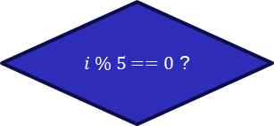
Adaptative Mesh Deformation Flowchart
End
Yes
Convergence ?
$$i←0$$
Initialize the mesh
Solve the magneto-harmonic equation,
Compute cost $J$
Start
No
Solve adjoint equations,
Compute shape derivative $J′(Ω)$,
Compute descent direction $−φ$
$$i←i+1$$
No
$i \% 5==0$ ?
Perform MMG remeshing
Yes
Move the mesh nodes:
$N_{i}←N_{i}−τφ_{i},$

Slide 20
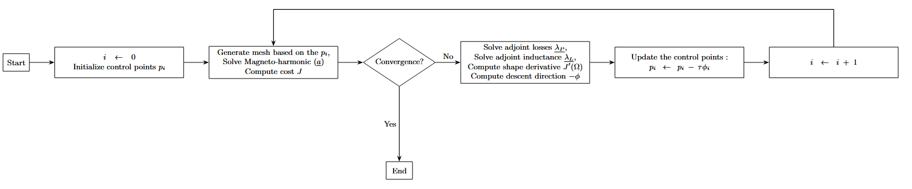
Control Points Flowchart
Fig. 14: Flowchart for the “control points” approach

Slide 21
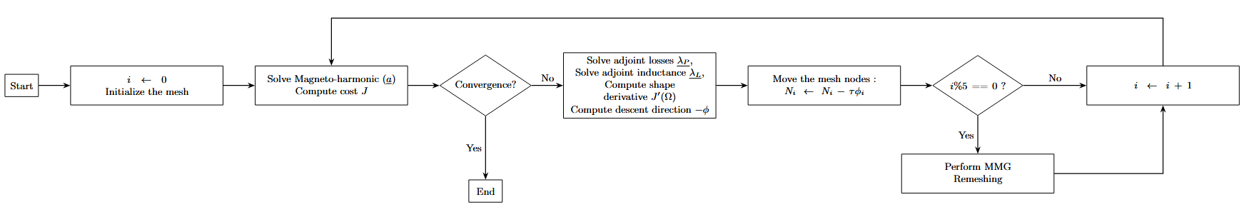
Adaptative Mesh Deformation Flowchart
Fig. 15: Flowchart for the “adaptative mesh deformation” approach

Slide 22
Part III – Optimization Results

Slide 23
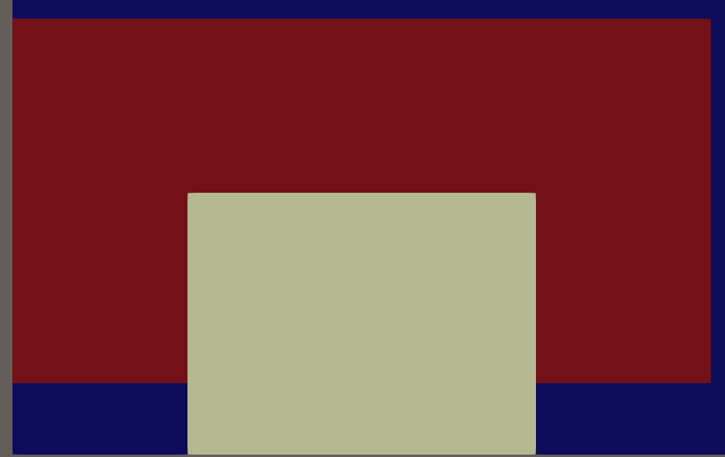
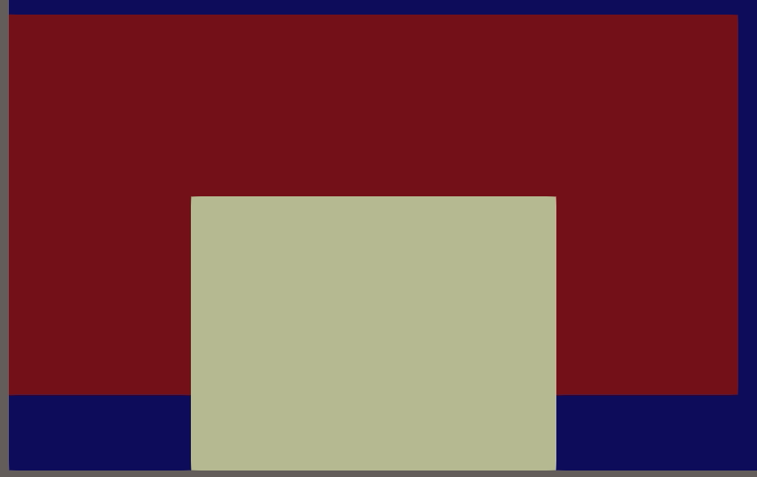
Results
Control points optimization results
Adaptative mesh deformation results

Slide 24
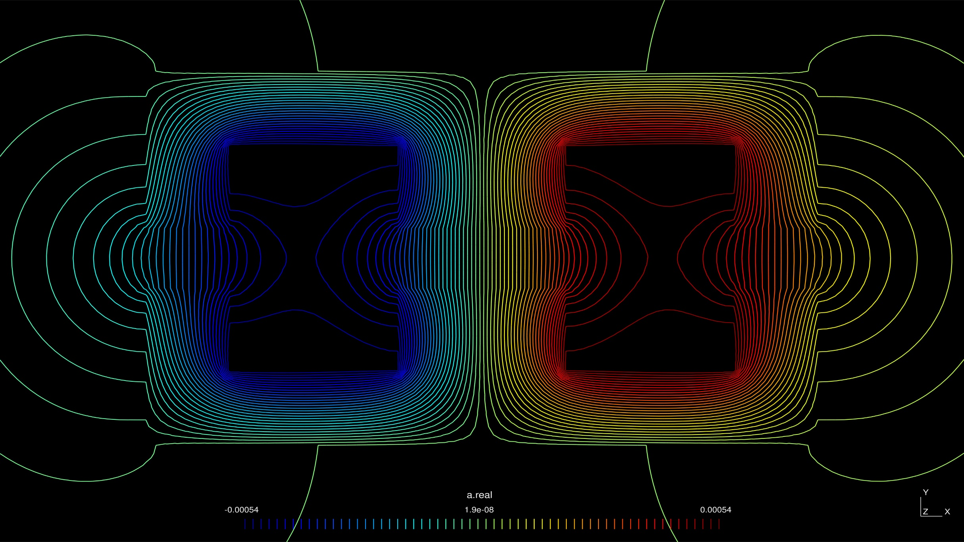

Slide 25
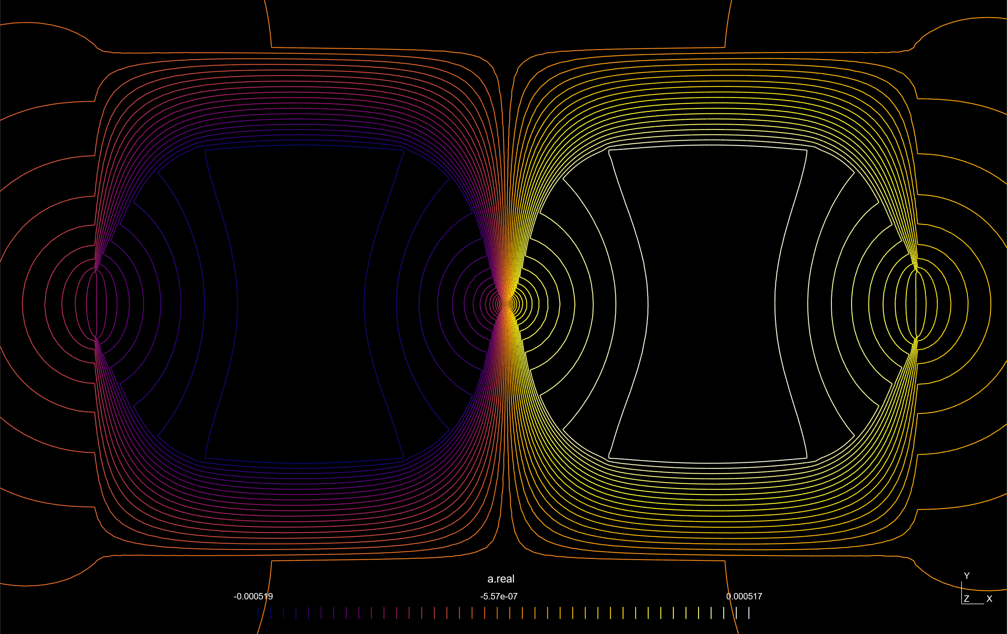

Slide 26
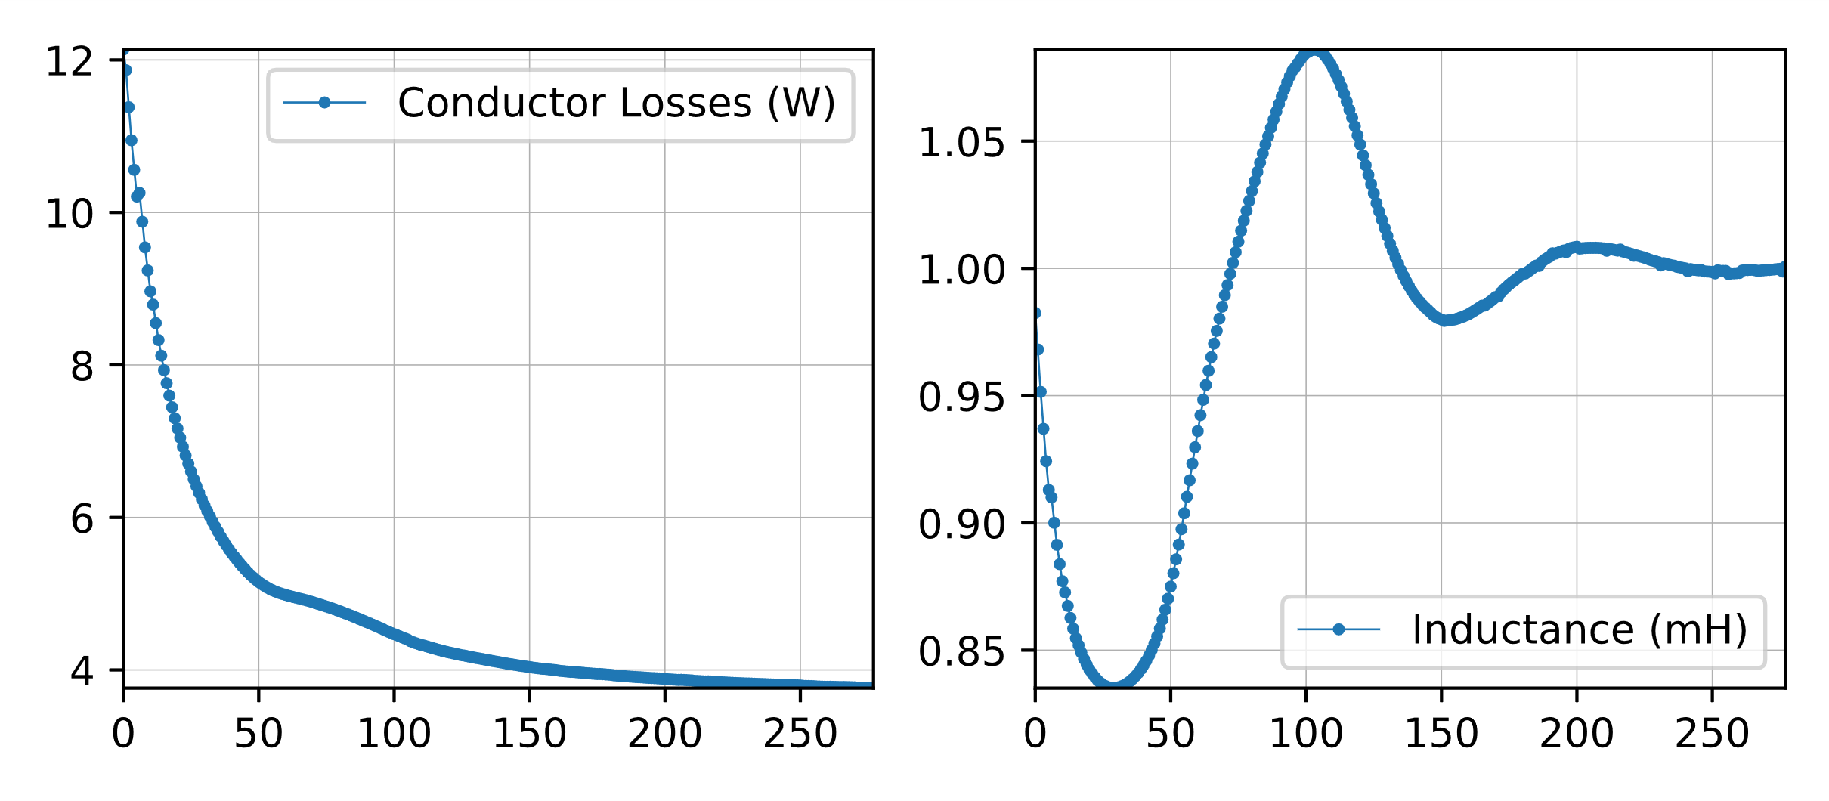
Results – Performance and Convergence
Optimization Type | Iterations | P (W) | L (mH)
Reference | - | 13.16 | 1.00
Control points | 92 | 6.00 | 1.00
Adaptative mesh deformation | 277 | 3.76 | 1.00
Optimization results
Adaptative mesh deformation convergence curves

Slide 27
Conclusion
We used gradient-based optimizations of the air gap profile of an inductor to minimize AC losses.
We leverage classical techniques such as:
Control points, mesh deformations, remeshing
Shape derivates
Adjoint method
Hilbertian extension-regularization
Perspective:
Include magnetic saturation in the optimization
Find better topology of the magnetic core
Include iron losses

Slide 28

Thank You!
Code available on zenodo

Slide 29
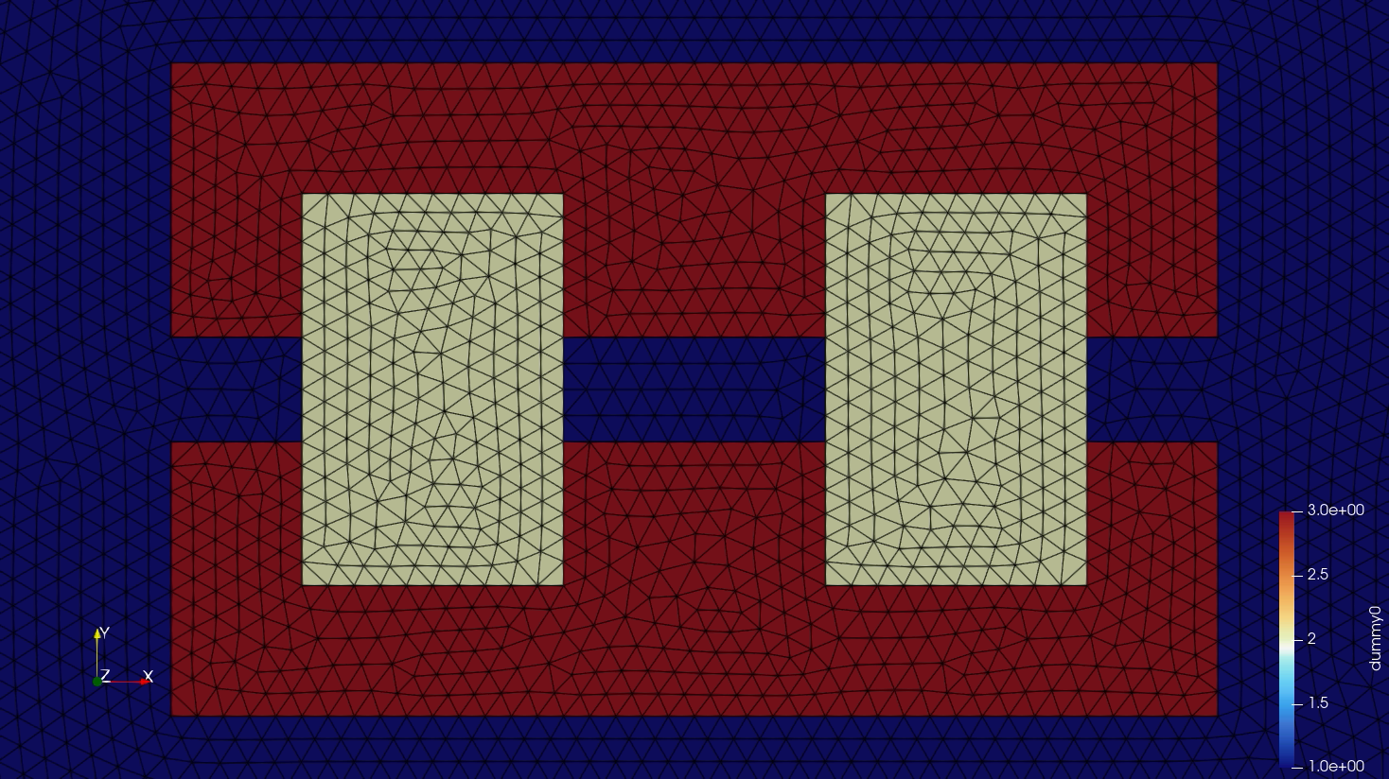
Results

Slide 30
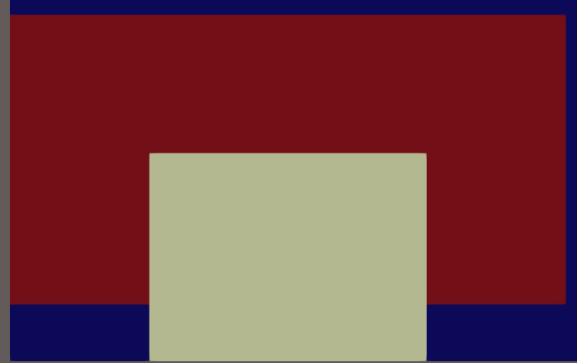
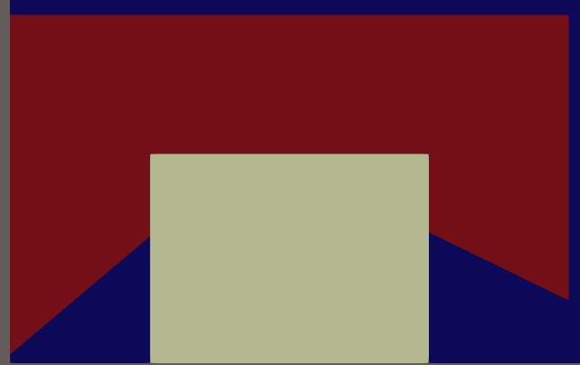

Results – Control Points

Slide 31
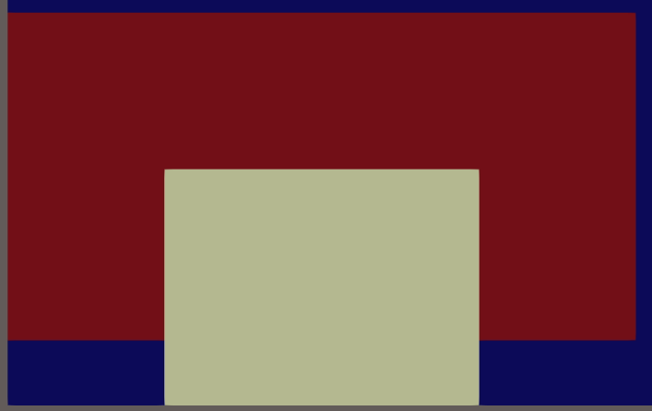
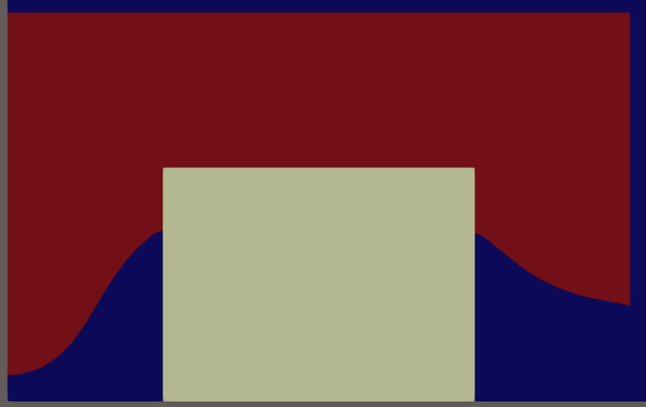
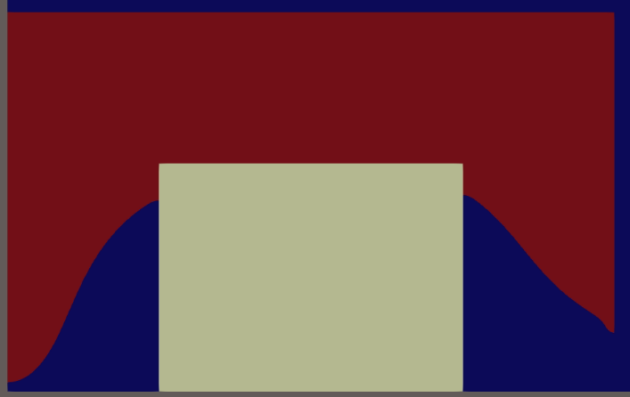

Results – Adaptative Mesh Deformation

Slide 32


Shape derivative of $J\left(Ω\right)= \int_{Ω}{fdx}$
The change of variables $T=Id+φ$ allows to transport the integral $J\left(Ω_{φ}\right)$onto the fixed reference domain $Ω$:
$$J\left(Ω_{φ}\right)=\int_{Ω_{φ}}{fdx}=\int_{Ω}{\left|det\left(I + ∇φ\right)\right| f}∘\left(Id +φ\right)dx.$$
Considering that:
$|det⁡(I+∇φ)|$is Fréchet differentiable at $φ=0$, expanding to $1+div\left(φ\right)+o\left(φ\right).$
$f∘(Id+φ)$is Fréchet differentiable at $φ=0$, expanding to $f+∇f⋅φ+o(φ)$.
By the product rule, $φ↦F\left(Ω_{φ}\right)$ is Fréchet differentiable at $0$, and its derivative is the volume form :
$$J^{′}\left(Ω\right)\left(φ\right)=\int_{Ω}{\left(div\left(φ\right)f + ∇f ⋅φ\right)dx}= \int_{Ω}{div\left(fφ\right)dx.}$$
Alternatively, if $Ω$ is a bounded and Lipschitz domain, an integration by parts gives the surface form :
$$J’\left(Ω\right)\left(φ\right)= \int_{∂Ω}{φ⋅n ds}.$$
Structural theorem : Under mild assumptions, if $φ.n=0$ on $∂Ω$ then $J’\left(Ω\right)\left(φ\right)$ = 0.
The derivation can be difficult for elaborate functions, particularly those constrained by PDEs.

Slide 33


Adjoint Method of $E\left(p\right)=F\left(a_{p}\right)$
We want to differentiate a $E\left(p\right)=F(a_{p})$ (e.g., the magnetic energy $E\left(p\right)=\int_{D}{ja_{p}dx}$) with respect to $p$, an arbitrary parametrization of the air gap profile. Here, $j$ is the current density, and $a_{p}$is the magnetic potential.
We introduce two equations:
The state equation $K\left(p\right)a_{p}=J$
The adjoint equation : $K{\left(p\right)}^{∗}λ_{p}=−\frac{dF}{da}(a_{p})$ where $K{\left(p\right)}^{∗}$ is the adjoint operator of $K(p)$.
Then, the sensitivities of $E(p)$ with respect to p can be expressed as :
$$\frac{dE}{dp}\left(p\right)=\left\langle λ_{p},\frac{dK}{dp}\left(p\right)a_{p}\right\rangle$$
The scalar product shown above varies based on how $K(p)$, $a_{p}$​, and $λ_{p}$​ are represented:
if they are in discretized form, it's an $ℝ^{n}$ scalar product, reflecting a "discretize then optimize" approach,
if they are in variational form, it's an $L^{2}(D)$ scalar product, reflecting an "optimize then discretize" approach.
Jean Céa’s method offers an elegant way to obtain this result.

Slide 34

Adjoint Method of $E\left(p\right)=F\left(a_{p}\right)$
The state equation can be expressed in two ways:
Discretized Form: A linear system where $K(p)$is the stiffness matrix and $J$ is the discretized current density vector:
$K\left(p\right)a_{p}= J$
Variational Form: Where $K(p)$is a linear operator and $J$is a linear form:
$$K\left(p\right): { H}^{1}\left(D\right)→H^{−1}\left(D\right) \\ a↦\left(v ↦\int_{D}{ν\left(p\right)∇a}⋅∇vdx\right) \\ J :H^{1}\left(D\right)→ℝ \\ v↦\int_{D}{jv}dx$$

Slide 35

Glimpse of Jean Céa’s method 1/3
To find the derivative of $E(p)$with respect to $p$, we introduce a lagrangian function:
$$L(p,a,λ)=F(a)+\left\langle λ,K\left(p\right)a−J\right\rangle$$
A key observation is that $E(p)=L(p,a_{p​},λ)$ for any $λ$. Applying the chain rule, we get:
$$\frac{dE}{dp}\left(p\right)=\frac{∂L}{∂p}\left(p, a_{p}, λ\right)+\left\langle \frac{∂L}{∂a}\left(p, a_{p},λ\right),\frac{da_{p}}{dp}(p)\right\rangle , ∀λ.$$
The challenge here is that $\frac{da_{p}}{dp}(p)$is difficult to define rigorously and compute.
Jean Céa’s proposal is to choose $λ$ such that the second term vanishes.
This is achieved by finding a saddle point of $L(p, ⋅, ⋅)$.

Slide 36

Glimpse of Jean Céa’s method 2/3
Recalling the lagrangian function we posed :
$$L(p,a,λ)=F(a)+\left\langle λ,K\left(p\right)a−J\right\rangle$$
Canceling with respect to $λ$, we obtain :
$$\left\langle \frac{∂L}{dλ}\left(p, a, λ\right), \hat{λ}\right\rangle \left.=\left\langle \hat{λ}, K\left(p\right)a− J\right.\right\rangle = 0, ∀\hat{λ},$$
which recovers our original state equation $K\left(p\right)a_{p}= J$.
Canceling with respect to $a$, we obtain
$$\left\langle \frac{∂L}{da}\left(p, a, λ\right), \hat{a}\right\rangle \left.=\left\langle \frac{dF}{da}(a), \hat{a}\right.\right\rangle + \left.\left\langle λ, K\left(p\right)\hat{a}\right.\right\rangle =0, ∀\hat{a}.$$
Using the definition of the adjoint operator $K{\left(p\right)}^{∗}$, this restates to
$$\left.\left\langle \frac{dF}{da}(a), \hat{a}\right.\right\rangle + \left.\left\langle K{\left(p\right)}^{∗}λ, \hat{a}\right.\right\rangle =0, ∀\hat{a},$$
which recovers our original adjoint equation $K{\left(p\right)}^{∗}λ_{p}=−\frac{dF}{da}(a_{p})$.
Thus, a saddle point of $L\left(p, ⋅, ⋅\right)$ is $\left(a, λ\right)=\left(a_{p},λ_{p}\right)$.

Slide 37

Glimpse of Jean Céa’s method 3/3
Recalling the lagrangian function we posed :
$$L(p,a,λ)=F(a)+\left\langle λ,K\left(p\right)a−J\right\rangle$$
At the saddle point $\left(a, λ\right)=\left(a_{p},λ_{p}\right),$we have:
$$\frac{dE}{dp}\left(p\right)=\frac{∂L}{∂p}\left(p, a_{p}, λ_{p}\right)+\left\langle \frac{∂L}{∂a}\left(p, a_{p},λ_{p}\right),\frac{da_{p}}{dp}(p)\right\rangle$$
Thus, the formula for sensitivities is :
$\boxed{\frac{dE}{dp}\left(p\right)= \frac{∂L}{∂p}\left(p, a_{p}, λ_{p}\right)=\left\langle λ_{p},\frac{dK}{dp}\left(p\right)a_{p}\right\rangle }$
Applying this approach to shape derivatives demands special care
and yields more intricate expressions.

